Slide 1
Innovative test solution
Provider
- Probe pin Datasheet -

Slide 2
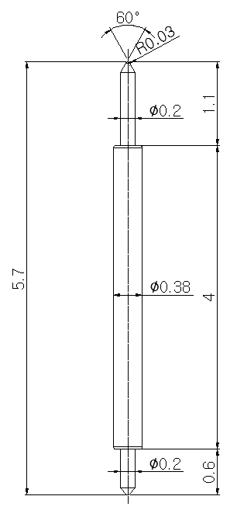
※ General POGO pin – 5.7mm / 0.5P
IVB-DAA-570-038-A188-00
Pitch | 0.5mm
Total Length | 5.7mm
Use Length | 5.05mm
Use Stroke | 0.65mm
Spring Force at Use Stroke | 13gf at 0.65mm Stroke
Operating Temperature | -40 to 200°C
DC Resistance | 85.0mΩ at 0.65mm stroke
Current Rating | 4.4A (Continuous)
Self Inductance | 1.57 nH
Bandwidth @ -1dB | 7.8 GHz
Top Plunger | BeCu / Au over Ni
Bottom Plunger | BeCu / Au over Ni
Barrel | PBT / Au over Ni
Spring | Stainless Steel / Au
Insertion Life | 100,000 cycles at 0.65mm Stroke

Slide 3
Thank you.

